Slide 1
Constrained Parametric Convolutional Sparse Coding A CSC model for parameterized Stroke Sketch Re-construction

Slide 2
Presentation Overview
Sketch Vectorization (What Why and How)
Overview on parametric Bezier curve fitting
Overview on Convolutional Sparse Coding (CSC) model
Structured Convolutional Sparse Coding, modified CSC

Slide 3
What is Sketch Digitization or Vectorization
It is to Geometrically represent a line drawing as a number of connected parameterized curves.
Vectorization provides a link between raster scans of pencil-and-paper drawings and modern digital processing algorithms that require accurate vector representations.
This is still an open area of interesting research! Even when input drawings are comprised of clean, crisp lines, inherent ambiguities make vectorization difficult.
Why to Digitize a Sketch?

Slide 4
How is it being handled so far?
Using of the self digitization technique as in Adobe-Illustrator.
https://www.youtube.com/watch?v=PaEUSkTqawE
Implement a sketch vectorization pipeline
Or avoid that by:
Collecting Sketches using Wacom Device which enables direct extraction of strokes and thus straight forward vectorization
Constructing Stroke Library of stroke images
Use a convolutional Sparse Coding inspired technique ☺

Slide 5
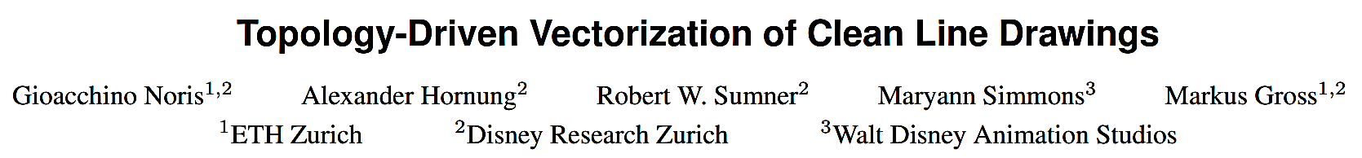
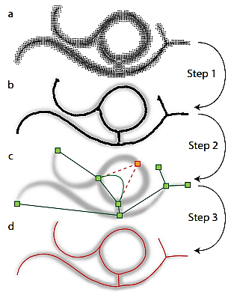
Notes:
First, our algorithm disambiguates
the input pixels using a gradient-based clustering process.
Step 2: From the clusters, the topological skeleton of the drawing
is extracted. Step 3: By utilizing the topological information, our
reverse drawing procedure extracts accurate centerline estimates
and junction positions.

Slide 6
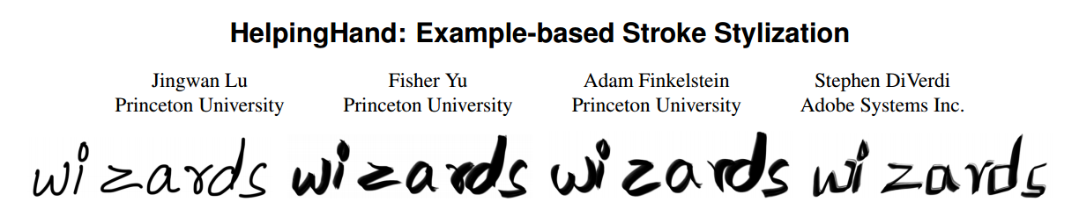
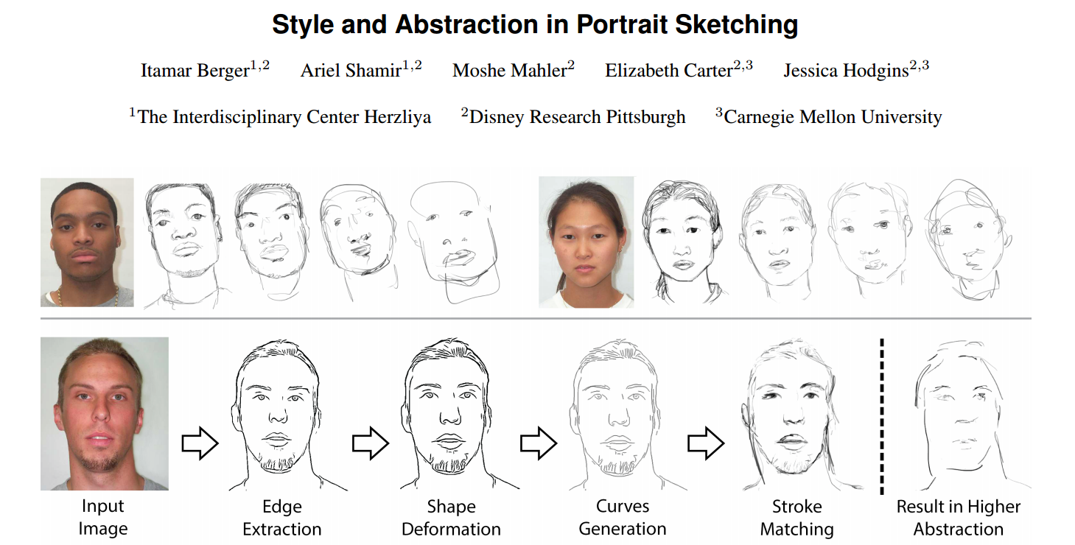

Slide 7
Curve Fitting
Overview on parametric Bezier curve fitting
Find a simple formula that follows the trend of given discrete data points
Allows positions in between data points to be calculated and drawn
Satisfies a pre-specified amount of smoothness
Notes:
“Computers can’t draw curves.”
The more points/line segments that are used, the smoother the curve.

Slide 8
“Computers can’t draw curves.”
The more points/line segments that are used, the smoother the curve.

Slide 9
Curve Fitting
Two approaches
Interpolation – fit the discrete data points exactly
Approximation – follow the trend of the data points closely,
control points (Bezier Curves)
but satisfy other criteria
satisfy a pre-specified amount of smoothness

Slide 10
Curve representation
Problem: How to represent a curve easily and efficiently
“Brute force and ignorance” approaches:
storing a curve as many small straight line segments
doesn’t work well when scaled
inconvenient to have to specify so many points
need lots of points to make the curve look smooth
working out the equation that represents the curve
difficult for complex curves
moving an individual point requires re-calculation of the entire curve

Slide 11
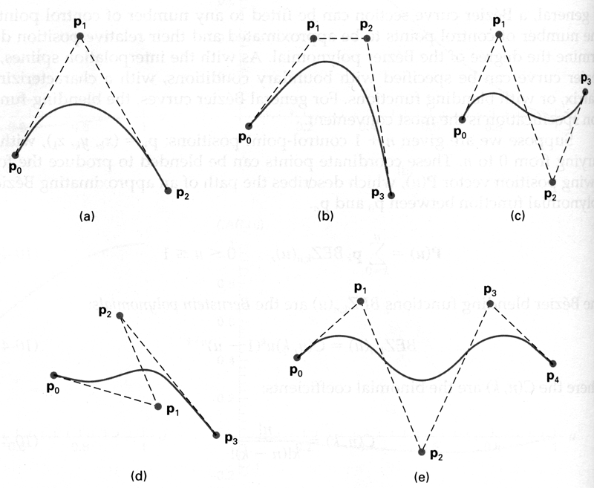
Bezier Curves
Example:

Slide 12
Bezier Curve Properties
The first and last control points are interpolated
The tangent to the curve at the first control point is along the line joining the first and second control points
The tangent at the last control point is along the line joining the second last and last control points
The curve lies entirely within the convex hull of its control points
The Bernstein polynomials (the basis functions) sum to 1 and are everywhere positive

Slide 13
Bezier Approximation

Slide 14
Convex Hull property

Slide 15
Linear Interpolation
Parametric representation, parameter t
Case of 2 control points P₀ , P₁ ,
P₀ , P₁ , may be points in 2D, or in 3D
B_{i}(t) are blending functions – fixed.
B_{i}(t) “blend” points P₀ , P₁

Slide 16
Linear Interpolation
Case of 2 control points P₀ , P₁ ,
parameter t
b₀(t)=1-t, b₁(t)=t are the blending functions.
Polynomial of degree 1
b₀(t) + b₁(t)= (1-t) + t = 1 for all t

Slide 17
Linear Interpolation
Q(t) : straight line join between P₀ and P₁

Slide 18
Linear Interpolation
t > 1
0<t<1
t < 0
Q(t) : straight line join between P₀ and P₁

Slide 19
Linear Interpolation
Calculation example with vectors
P₀ = (1,4,2), P₁ = (5,8,2)

Slide 20
Linear Interpolation
Calculation example with vectors
P₀ = (1,4,2), P₁ = (5,8,2)

Slide 21
Linear Interpolation
Calculation example with vectors
P₀ = (1,4,2), P₁ = (5,8,2)

Slide 22
Linear Interpolation
Calculation example with vectors
P₀ = (1,4,2), P₁ = (5,8,2), t = 1/4

Slide 23
Linear Interpolation
The sum of weights satisfies (1-t) + t = 1
This ensures that Q(t) lies on the line joining P₀ and P₁.
t in [0,1] ensures weights (1-t), t are non-negative
This ensures Q(t) lies strictly between or on P₀ and P₁
_{WATCH OUT FOR GENERALISATIONS!}

Slide 24
Linear Interpolation
Parametric representation, parameter t
P₀ , P₁ , P₂ ,… P_{N} may be points in 2D, or in 3D
b_{i}(t) “blend” points P₀ , P₁ , P₂ ,… P_{N}

Slide 25
Linear Interpolation
Parametric representation, parameter t
As t varies, e.g. between 0 and 1, Q(t) traces out a trajectory – a blending of the control points

Slide 26
De Casteljau algorithm
Can compute any point on the curve in a few iterations
No polynomials, pure geometry
Repeated linear interpolation
Repeated order of the curve times
The algorithm can be used as definition of the curve

Slide 27
De Casteljau algorithm
Third order, u=0.75

Slide 28
De Casteljau algorithm

Slide 29
De Casteljau algorithm

Slide 30
De Casteljau algorithm

Slide 31
De Casteljau Algorithm

Slide 32
Convolutional Sparse Coding - Overview
Convolutional
Sparse
Coding

Slide 33


How to encode this image?

Slide 34


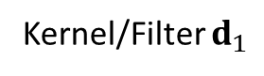
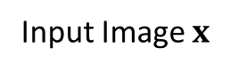
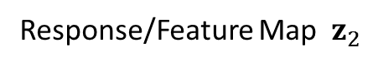
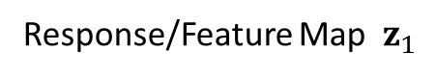
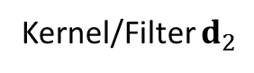
How to encode this image?
Response/Feature Map $z_{1}$
Kernel/Filter $d_{1}$
Input Image $x$
Response/Feature Map $z_{2}$
Kernel/Filter $d_{2}$

Slide 35
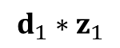
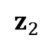
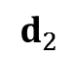
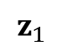
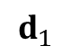
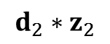
How to encode this image?
$$d_{1}$$
$$d_{2}$$
$$z_{1}$$
$$z_{2}$$
$$d_{1}∗z_{1}$$
$$d_{2}∗z_{2}$$

Slide 36
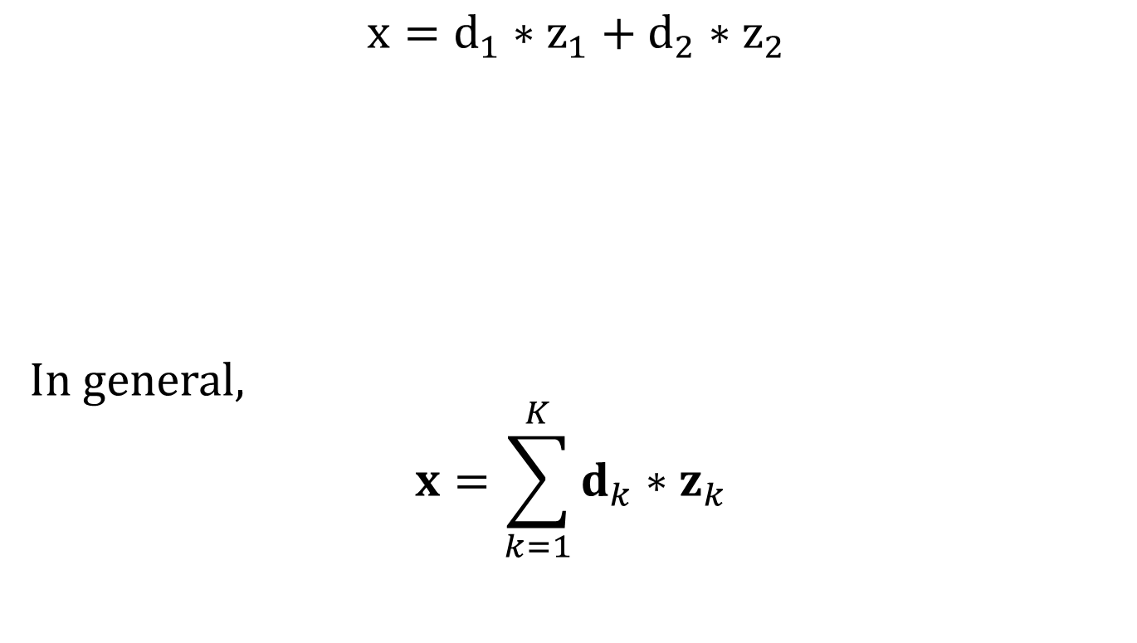
Convolutional Based Representation
$$x=d_{1}∗z_{1}+d_{2}∗z_{2}$$
In general,
$$x=\sum_{k=1}^{K}{d_{k}∗z_{k}}$$
Notes:
CSC represents an image by a sum of convolutional responses generated from image filters and sparse maps. These filters constitute a CSC dictionary D = {d1,...,dK}, and when convolved with their corresponding sparse maps Z = {z1,..., zK},

Slide 37
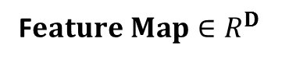
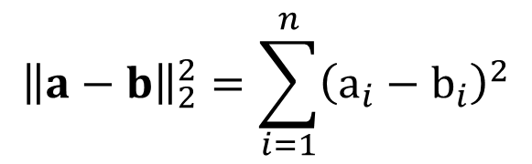

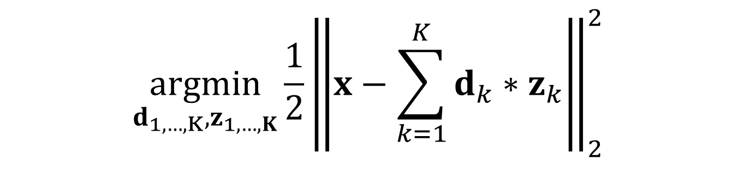
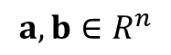
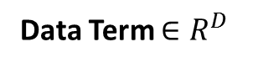
Convolutional Coding
$$\underset{d_{1,…,K},z_{1,…,K}}{argmin}{\frac{1}{2}{\left\|x−\sum_{k=1}^{K}{d_{k}∗z_{k}}\right\|}_{2}^{2}}$$
Data Term $∈R^{D}$
Convolutional K$ernel∈R^{M}$
F$eature Map∈R^{D}$
Minimize the square of the $L_{2}$ norm of the difference
$${\left\|a−b\right\|}_{2}^{2}=\sum_{i=1}^{n}{{\left(a_{i}−b_{i}\right)}^{2}}$$
$$a,b∈R^{n}$$

Slide 38
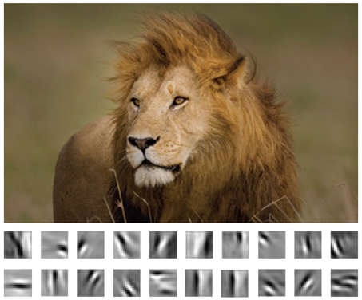
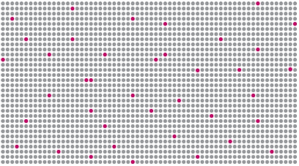
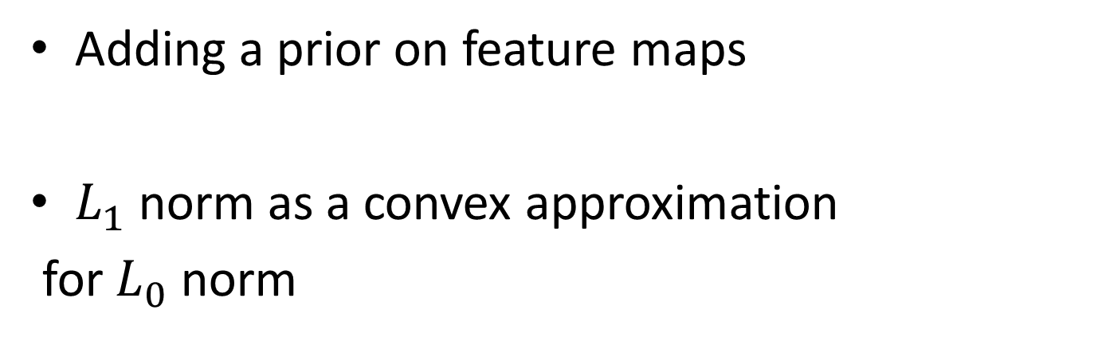
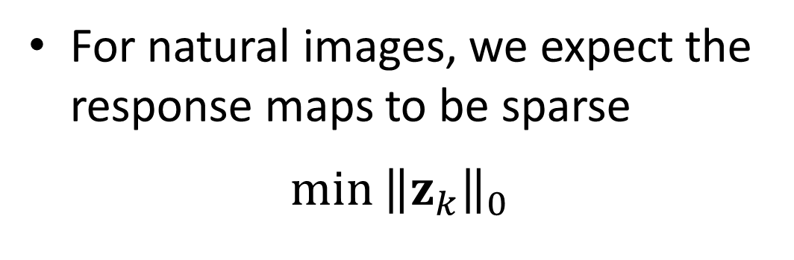
Sparse Prior on Feature Maps
For natural images, we expect the response maps to be sparse
$$\min{{\left\|z_{k}\right\|}_{0}}$$
Adding a prior on feature maps
$L_{1}$ norm as a convex approximation
for $L_{0}$ norm

Slide 39
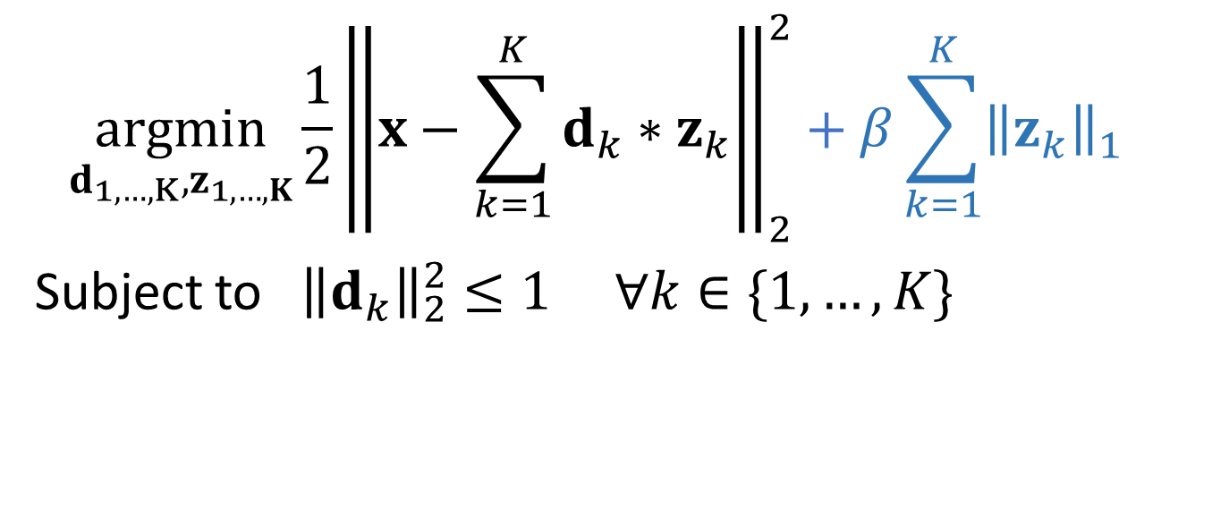
Convolutional Sparse Coding
$$\underset{d_{1,…,K},z_{1,…,K}}{argmin}{\frac{1}{2}{\left\|x−\sum_{k=1}^{K}{d_{k}∗z_{k}}\right\|}_{2}^{2}+β\sum_{k=1}^{K}{{{\left\|z_{k}\right\|}_{1 }}_{}}}$$
Subject to ${\left\|d_{k}\right\|}_{2}^{2}≤1 ∀k∈\{1,…,K\}$
Notes:
Prevents the dictionary from absorbing all of the system’s energy

Slide 40

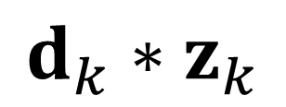
Convolution as Matrix Multiplication
$$d_{k}∗z_{k}$$
1 | 2 | 3 | . | . | . | 7
8
.
. |  |  | .
. |  |  |  | .
 |  |  |  |  | .
 |  |  |  |  |  | 49
1 | 2 | 3
4 | 5 | 6
7 | 8 | 9
$$∗$$
Notes:
Transforming the convolution to matrxi multiplication

Slide 41
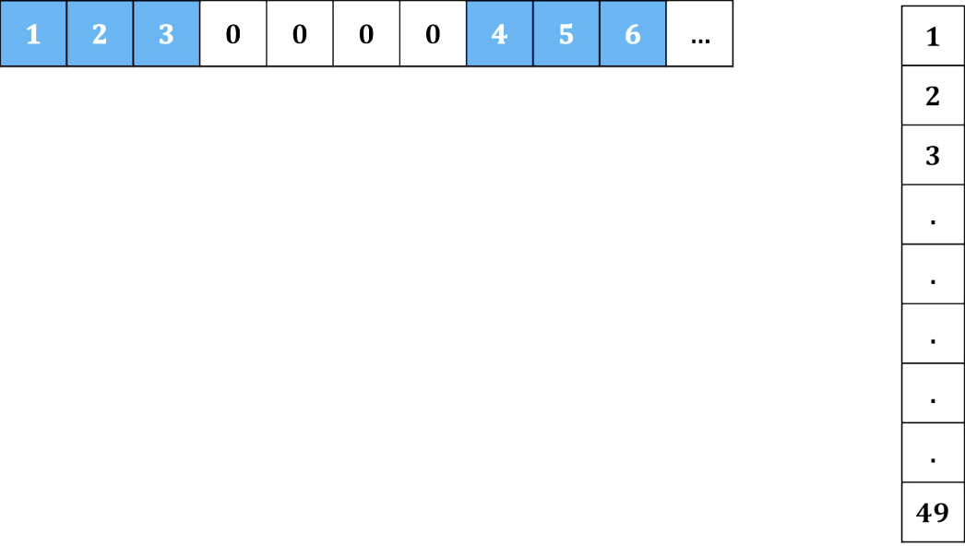
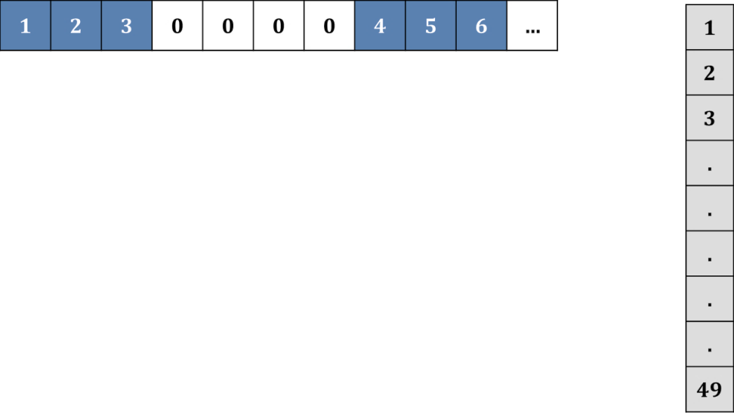

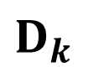
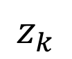
1 | 2 | 3 | . | . | . | 7
8
.
. |  |  | .
. |  |  |  | .
 |  |  |  |  | .
 |  |  |  |  |  | 49
1 | 2 | 3
4 | 5 | 6
7 | 8 | 9
$$z_{k}$$
$$D_{k}$$
Convolution
Matrix
Notes:
Results in Toeplitz matrices and their concatenation is now the new matrix D.

Slide 42
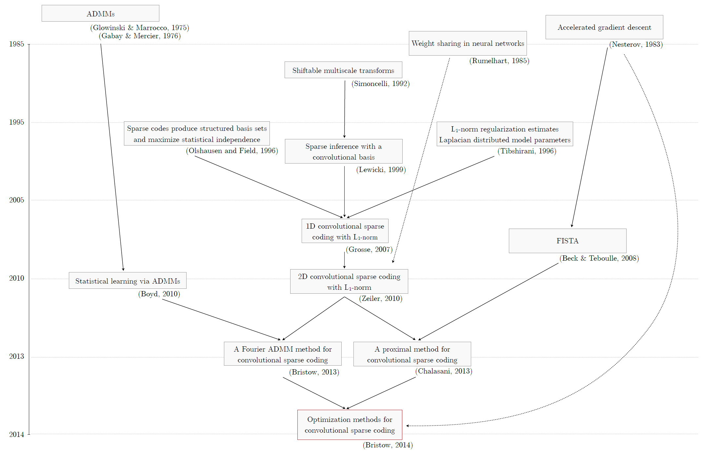
How to Solve the Optimization?
Seminal Advances
- Proper Boundary conditions
- Inference from incomplete data
- Faster convergence
2015
Fast and Flexible Convolutional Sparse Coding
(Heide, 2015)
Notes:
Now in this paper more flexible constraints to CSC are added with faster and betters convergence

Slide 43
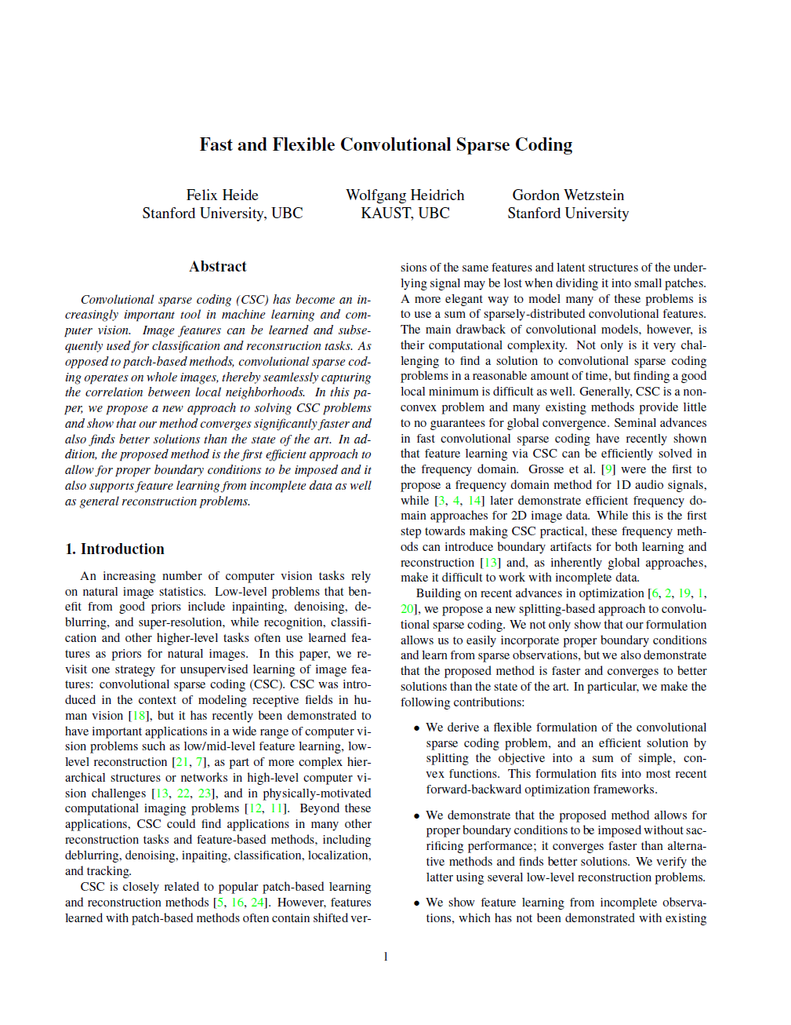
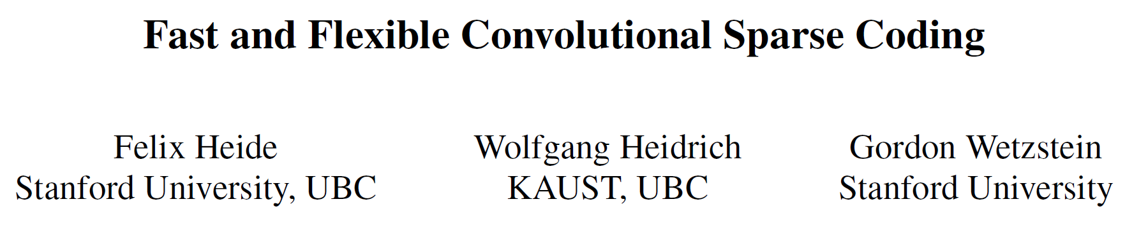
Most Recent Flexible Approach
CVPR 2015

Slide 44
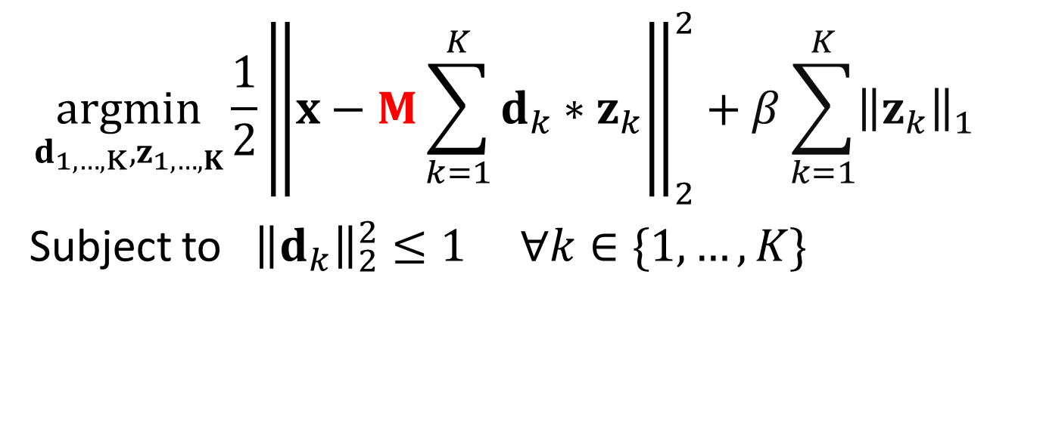
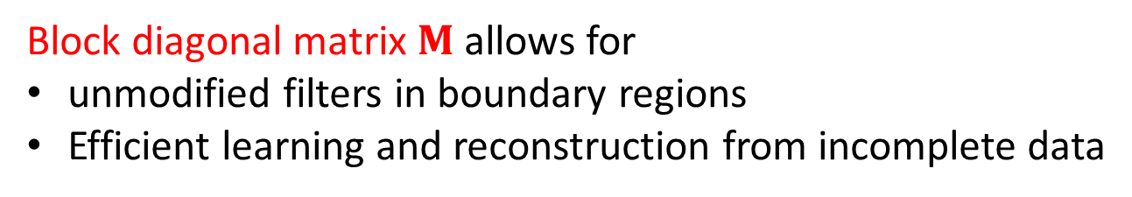
General Formulation
$$\underset{d_{1,…,K},z_{1,…,K}}{argmin}{\frac{1}{2}{\left\|x−M\sum_{k=1}^{K}{d_{k}∗z_{k}}\right\|}_{2}^{2}+β\sum_{k=1}^{K}{{{\left\|z_{k}\right\|}_{1 }}_{}}}$$
Subject to ${\left\|d_{k}\right\|}_{2}^{2}≤1 ∀k∈\{1,…,K\}$
Block diagonal matrix $M$ allows for
unmodified filters in boundary regions
Efficient learning and reconstruction from incomplete data
Notes:
By introducing the matrix M, this adds constraints on the boundary regions. And it allows for efficient learning and reconstruction from incomplete data. However, this generalization makes it impossible to solve directly with the fourrier trick. Noctice that this is similar to the formulation of the optimization reached in the previous paper. The difference is that there d/h was given.

Slide 45
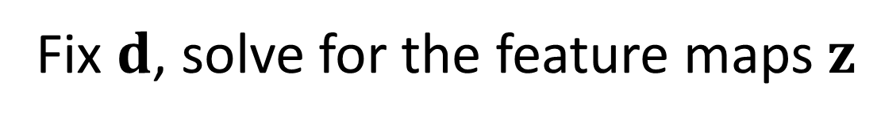
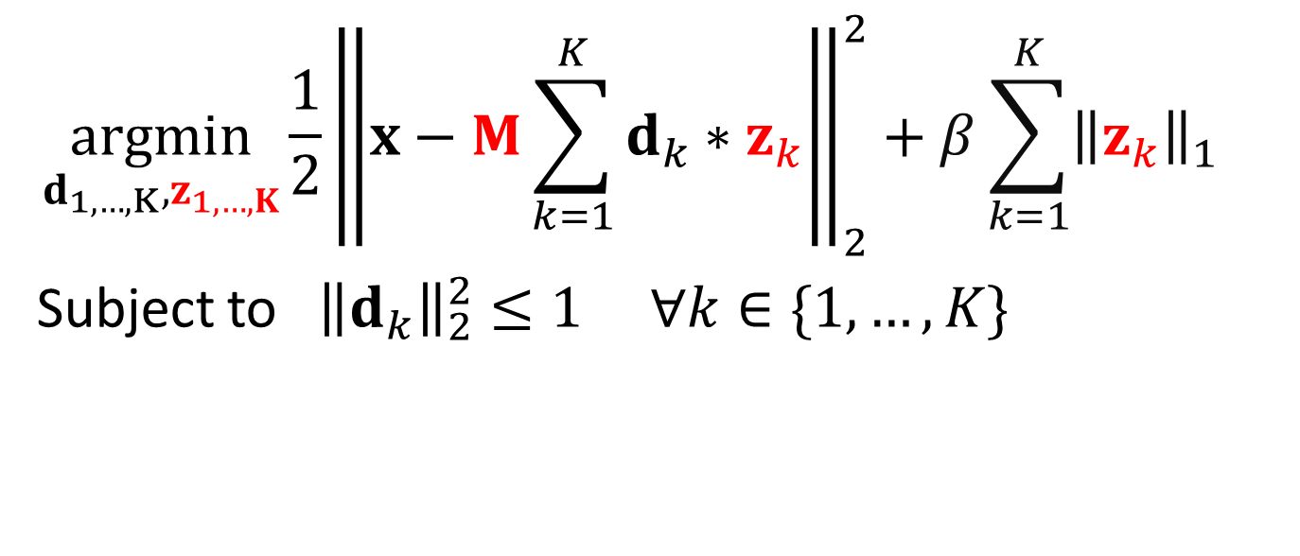
Splitting the Objective
$$\underset{d_{1,…,K},z_{1,…,K}}{argmin}{\frac{1}{2}{\left\|x−M\sum_{k=1}^{K}{d_{k}∗z_{k}}\right\|}_{2}^{2}+β\sum_{k=1}^{K}{{{\left\|z_{k}\right\|}_{1 }}_{}}}$$
Subject to ${\left\|d_{k}\right\|}_{2}^{2}≤1 ∀k∈\{1,…,K\}$
Fix $d$, solve for the feature maps $z$
Inferring Feature Maps Step

Slide 46
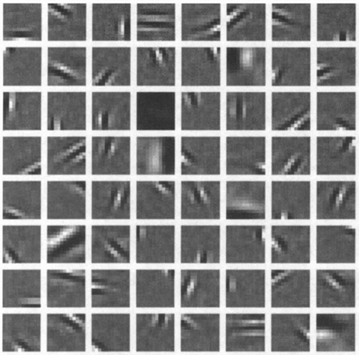
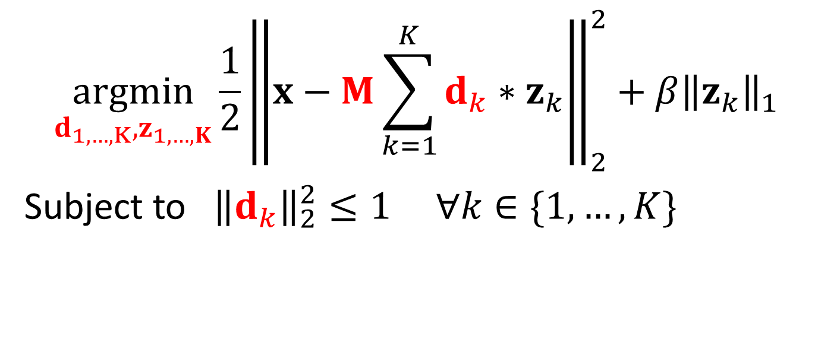
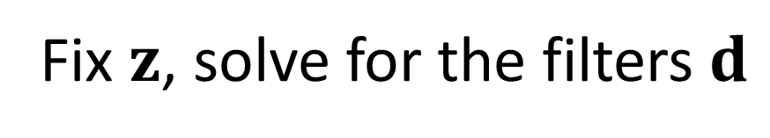
Splitting the Objective
$$\underset{d_{1,…,K},z_{1,…,K}}{argmin}{\frac{1}{2}{\left\|x−M\sum_{k=1}^{K}{d_{k}∗z_{k}}\right\|}_{2}^{2}+{β\left\|z_{k}\right\|}_{1}}$$
Subject to ${\left\|d_{k}\right\|}_{2}^{2}≤1 ∀k∈\{1,…,K\}$
Fix $z$, solve for the filters $d$
Filter Update Step

Slide 47
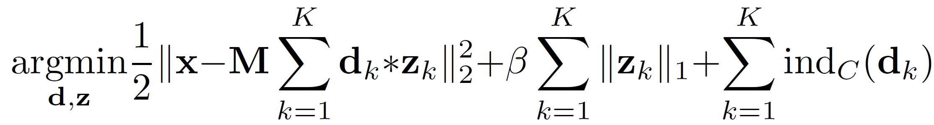
Splitting of Objective
move the constraints to the objective
Notes:
Now bymoving the constraints to the objecive, it can be expressed as a sum of functions while concatenating z and reformulating the convolution as a matrix multiplication.

Slide 48
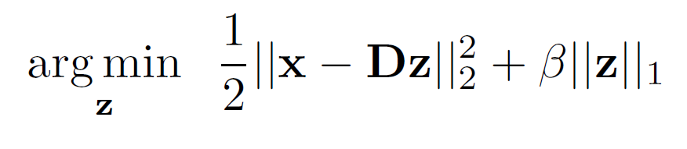
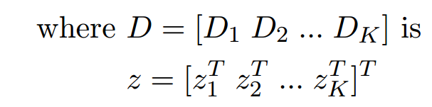
z-subproblem

Slide 49
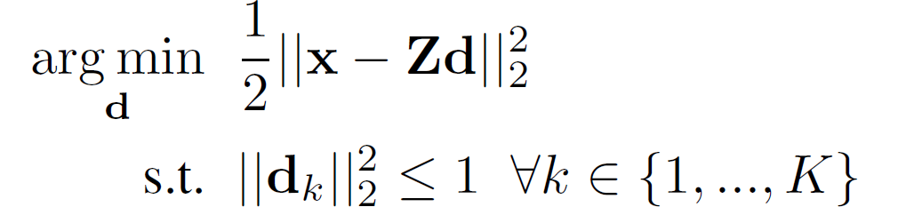
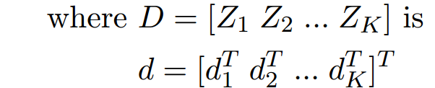
d-subproblem
3
Notes:
One approach to solve each of the above subproblems is casting it in an ADMM framework. We will start by first showing the general ADMM algorithm and then how it is applied for CSC-specific subproblems.

Slide 50
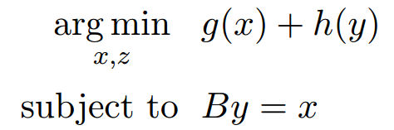
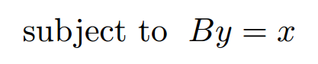
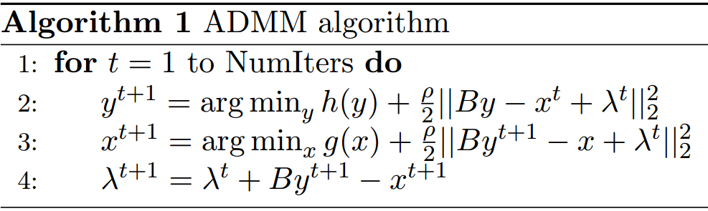
ADMM Approach

Slide 51




ADMM Approach
0
$$f$$
$$K$$
Notes:
In general
One approach to solve each of the above subproblems is casting it in an ADMM framework. We will start by first showing the general ADMM algorithm and then how it is applied for CSC-specific subproblems. al ADMMs can be solved by this iterative algorithmm.
To apply ADMM to CSC subproblems, we set h(y) = 0, g = f, A = 0, B = K, and x = v, with v = Ky and f(v) = PI i=1 fi(vi) = PJ i=1 Kjyi .

Slide 52


ADMM for CSC
2
3

Slide 53



Alternating for the biconvex problem
ADMM for $d$
inner iterations
outer iterations
ADMM for $z$
inner iterations

Slide 54
Now what?
Can we design Convolutional Sparse Coding to deal with parametric curves?
CSC is a valid model for sketch reconstruction (empirical study)
Notes:
In our work, we utilize CSC in implementing the brush-style transfer stage motivated by the way image reconstruction takes place in such a model. As discussed above, CSC reconstructs an image using a summation over a convolution between response maps Z specifying where in the image a response takes place and a set of filters D, which reflect what the response (stroke) will look like. We believe that this model approximates how an artist would draw a sketch, i.e. making the decision where to draw a stroke and what the stroke will look like (from a dictionary of strokes), except that it is a union operation rather than a pixel-level summation as in CSC.
Emprical Study !!
This is done using the s
patial and temporal information generated from the Wacom.

Slide 55






Stroke Extraction

Slide 56






Stroke Extraction

Slide 57


Slide 58

Constrained Parametric CSC
Add a constraint to the CSC objective such that updates filters are restricted to be in the set of all parametric cubic Bezier curves (S).

Slide 59

d-subproblem
3

Slide 60

d-subproblem
3

Slide 61

d-subproblem – Augmented Lagragian

Slide 62

ADMM approach

Slide 63



Proximal Operator for parametric function
Updated d:
Updated u:
The curve that minimizes the L2 norm difference with an image filter

Slide 64

Proximal Operator for parametric function

Slide 65


Assessment of Digitization Model
Original Stroke
Digitized Stroke

Slide 66



Initial Filters d1
Input Image
Final Parametric Filters dfinal
Reconstructed Image

Slide 67


Slide 68
Thank You ☺

Slide 69



dk
dk
dk
dk
dk
d1
d1
d1
d1
d1
Input T
Threshold & Extract Centerline
Apply Curve Fitting
Copy Original Intensities on T
Apply Quadratic Projection

Slide 70




d1
d2
d3
d4
dk
Input Image
Z1
Z2
Zk
Reconstructed Image

